Slide 1
A Stock Tracking Website With Social Networking Features
A Senior Project presented to the Faculty of the Computer Science Department of Charleston Southern University
By
Christopher Kyle Flynn

Slide 2
Links
https://github.com/ckyleflynn/newStockApp
https://damp-ravine-90473.herokuapp.com/users/sign_in

Slide 3
Statement Of Purpose
I wanted to create a website that would allow anyone to follow and watch particular stocks they are curious about and see how they are doing. I also wanted to allow people to see what stocks their friends where following as well
I wanted to build a website with a back end and front end

Slide 4
Research And Background
Ruby on Rails
Devise for Authentications
Rails databases including many to many and one to many
IEX Finance API
Website Study – A real analysis of web page layout and user management

Slide 5
Hardware and Software Required For Project
Devise
Ruby 2.6.6
Rails 6.0.2.2
Heroku
Github
Atom
Rails Console
Bash
JS/JSON
HTML
CSS
Bootstrap
IEX Finance API
More included in the Gemfile

Slide 6
Future Enchantments
Show more stock information that includes graphs
Section for personal notes by the user
Messaging between friends
A stock notification feature what would email or message the user when a stock reached particular price

Slide 7
Challenges Overcome
Learning ruby on rails
Learning the stock price API
Effective testing
Time Management

Slide 8
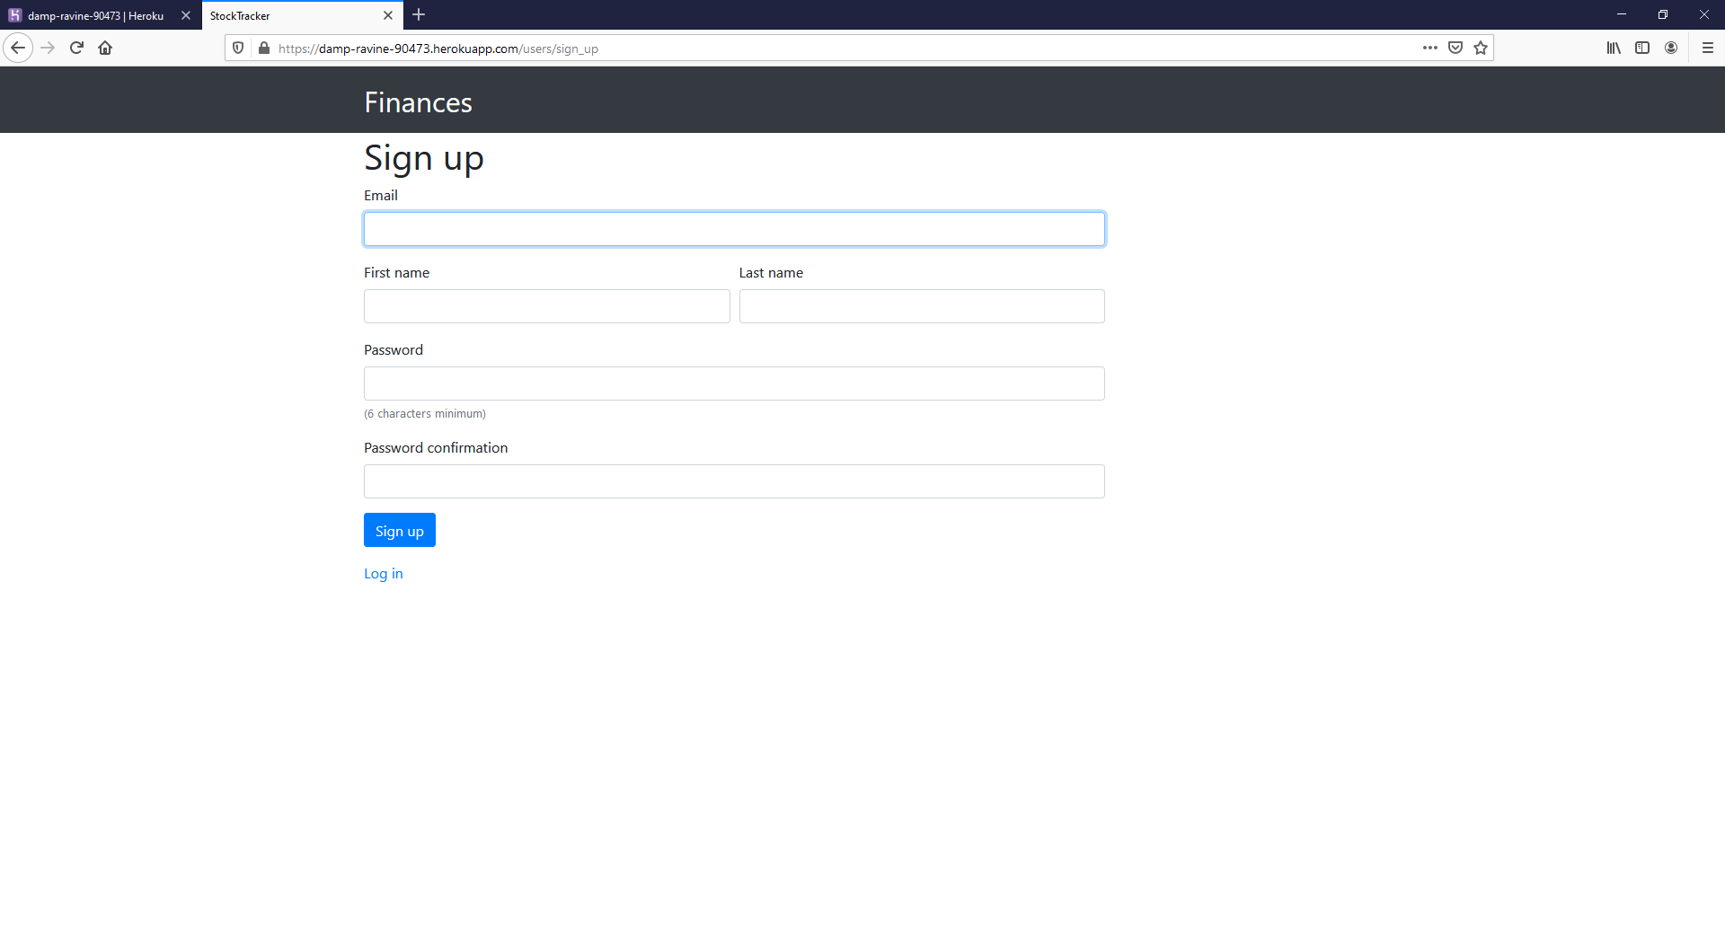
Sign up Page

Slide 9
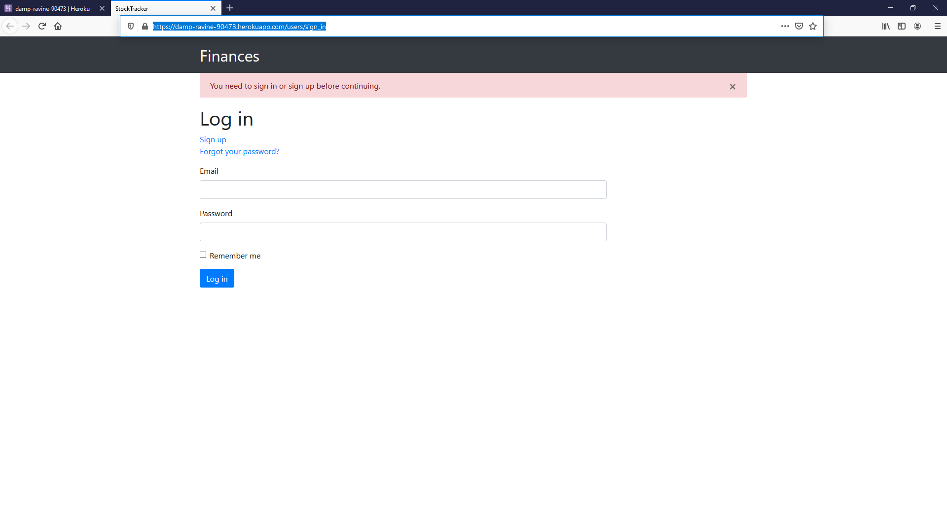
Log in Page

Slide 10
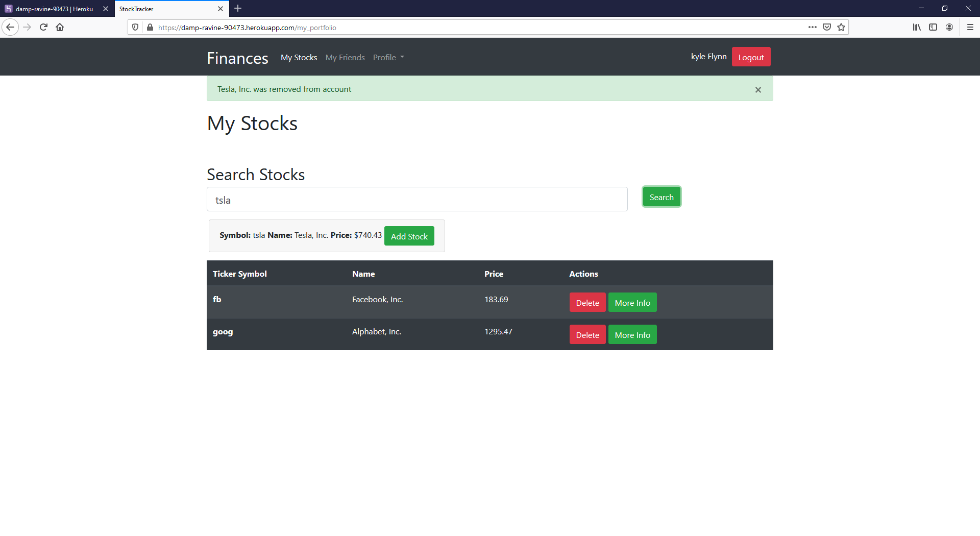
Stock search and add page

Slide 11
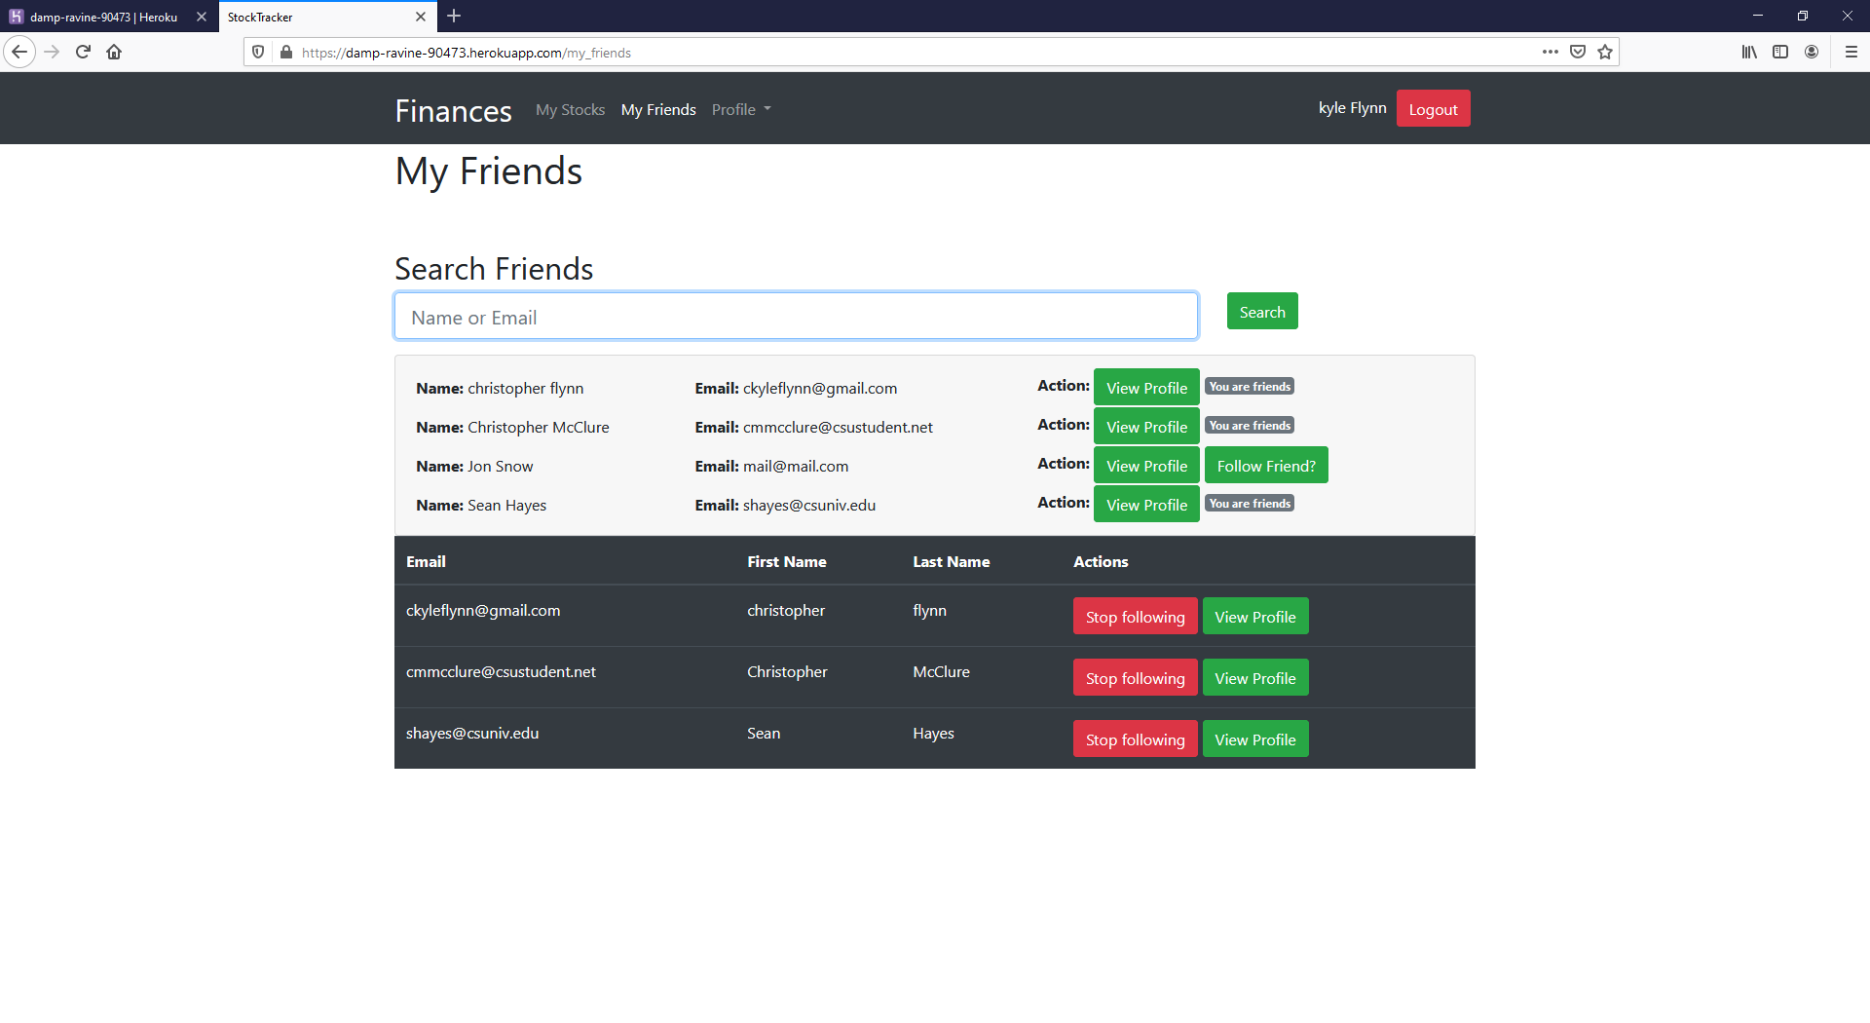
Friend Search Page

Slide 12
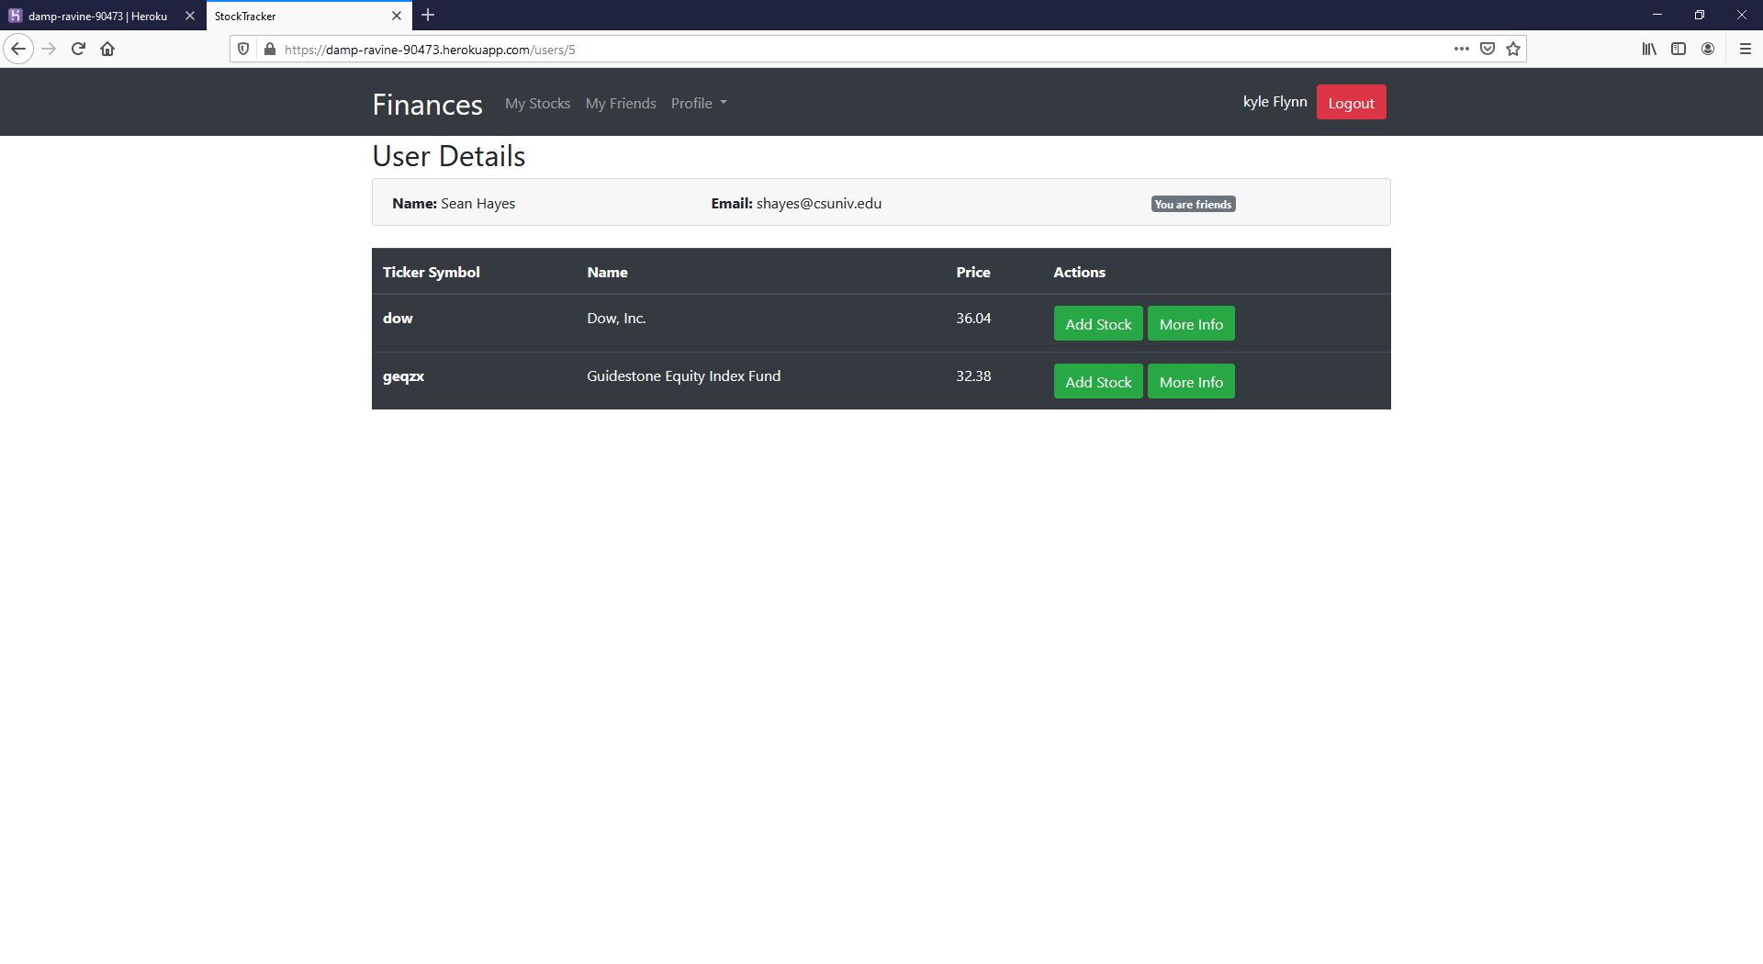
Friend’s Stocks

Slide 13
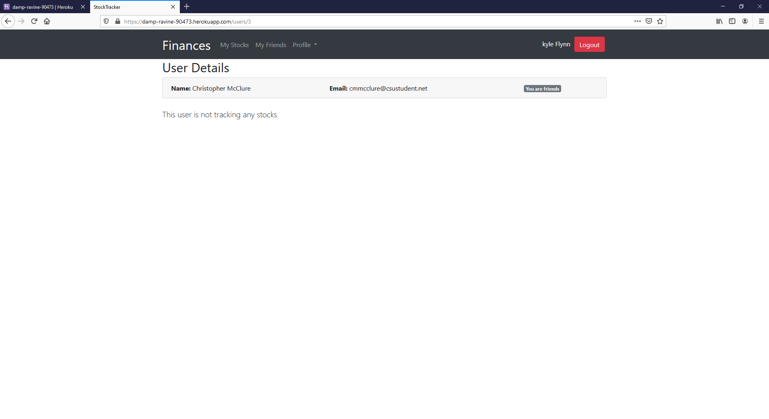
Friends not following any stocks

